Slide 1


Slide 2

Christopher Shannon
Brian Del Carpio
Ian Wu
Simon Fraser University
CMPT 276

Slide 3
PROJECT OVERVIEW
Objective:
- Save users time when scheduling workouts
- Give users consistency so they can see their daily activities from one app
- Deliver an application to streamline the process of tracking workout schedules
- Bridge between Strava and Google Calendar
Technologies and Process:
- JavaScript/React, HTML, CSS
- Agile Kanban SDLC

Slide 4

GOOGLE CALENDAR API
1) Create Events in google calendar
2) Recall past Events
3) Store events title, date, time and description

Slide 5

STRAVA API
1) Create Events in Strava
2) Recall past Events
3) Store the events, date, time and descriptions

Slide 6
PROJECT FEATURES
Plan Future Workouts:
- user inputs date and time
- uploads to google calendar
See Upcoming Workouts:
- user receives list of date and times of upcoming workouts
Input Workouts:
- user inputs distance and duration of workout
- uploads to Strava
Recall Past Workouts:
- user receives list of past workouts date times

Slide 7

CI/CD infrastructure
JavaScript/React – Frontend library used to build interactive user interfaces
HTML – Markup language, structures web applications
CSS - Styles websites aesthetically
GitHub - Version Control Software

Slide 8

Integration of Multiple APIs:
- Successfully integrated Strava and Google Calendar
- Enhanced the scheduling and tracking functionalities
User Experience Optimization:
- Intuitive and user-friendly interface
- Simplifying processes for booking and managing workouts
Responsive Design:
- Developed a responsive web design
- Seamless experience across different platforms
Testing and Quality Assurance:
- Rigorous testing ensured reliability and performance
- Stable and bug-free Application
Project Takeaways

Slide 9

API Integration Complexities:
- Individual integrations were not straightforward
- Combining integrations required detailed technical understanding
Cross-Platform Compatibility:
- Significant challenges to maintain functionality and appearance
consistent
Performance Optimization:
- Quick loading times and smooth performance
User Data Security:
- Implementing extensive measures to protect sensitive data
Compliance and Legal Considerations:
- Addressing legal and compliance aspects
- User data, Third party API usage
Challenges

Slide 10
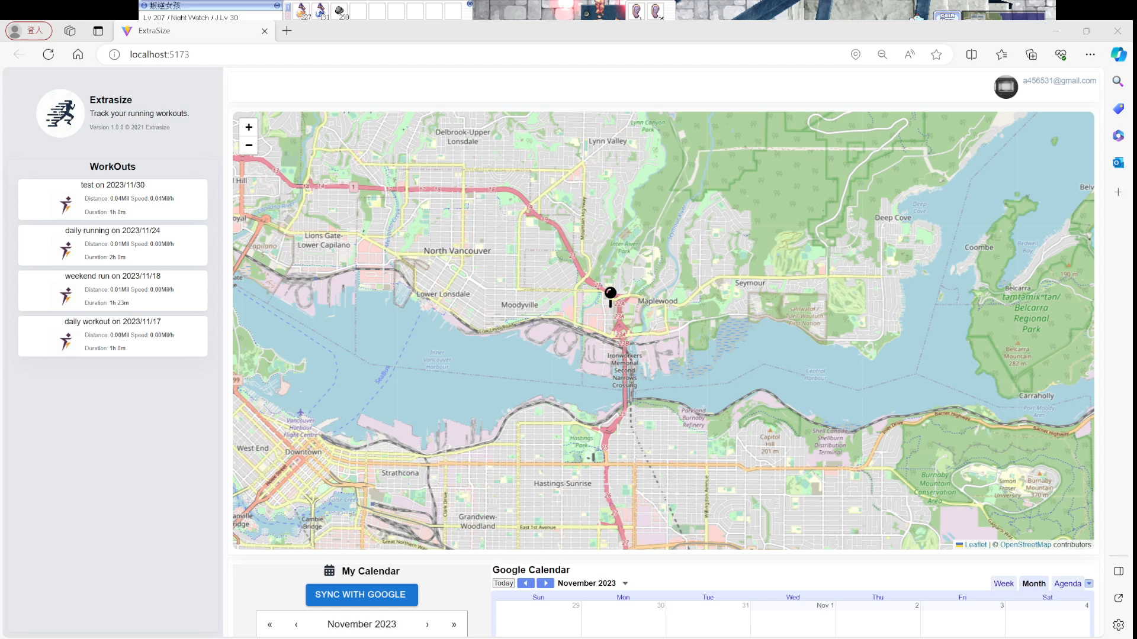
Video Demonstration
Youtube link

Slide 11
Thank you!

